Slide 1

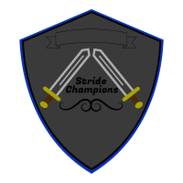

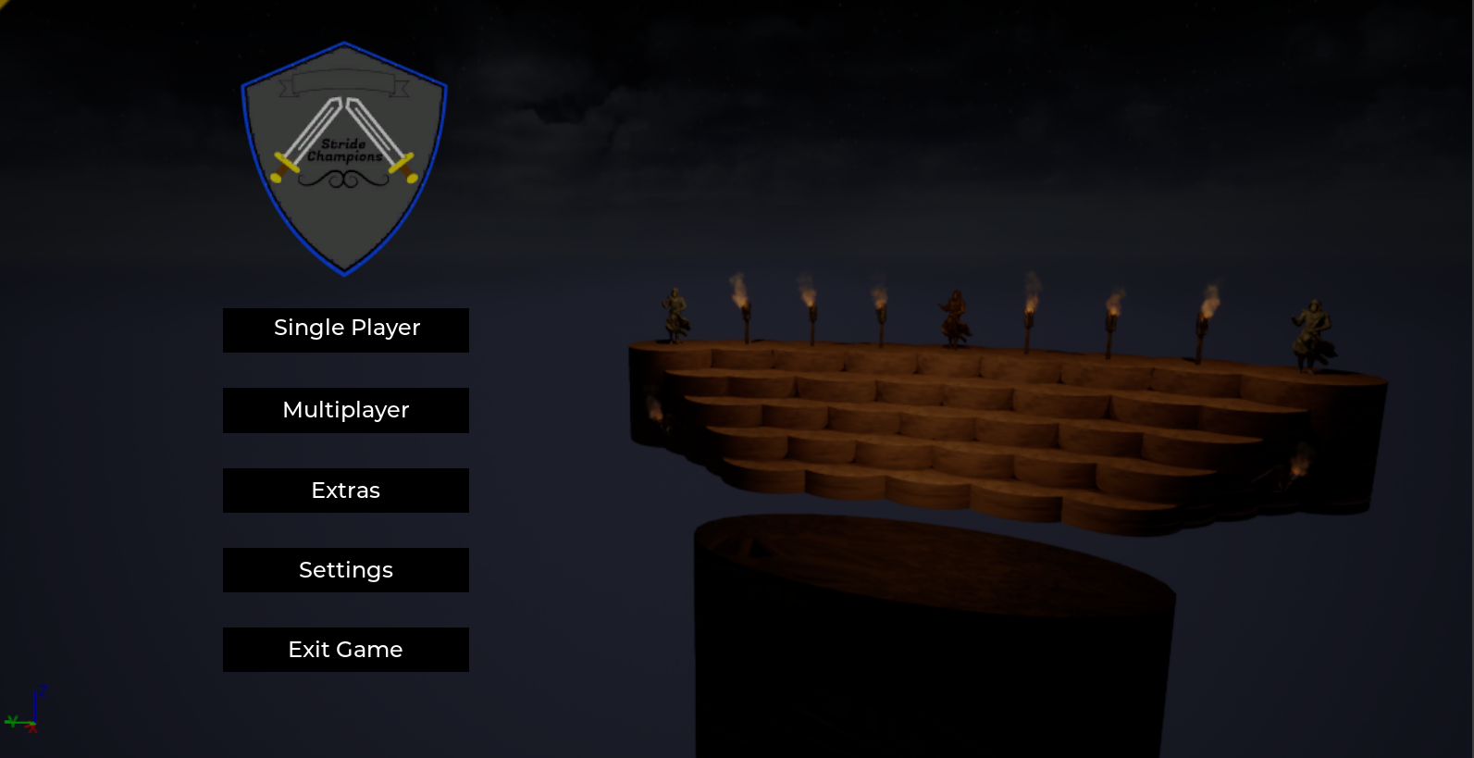
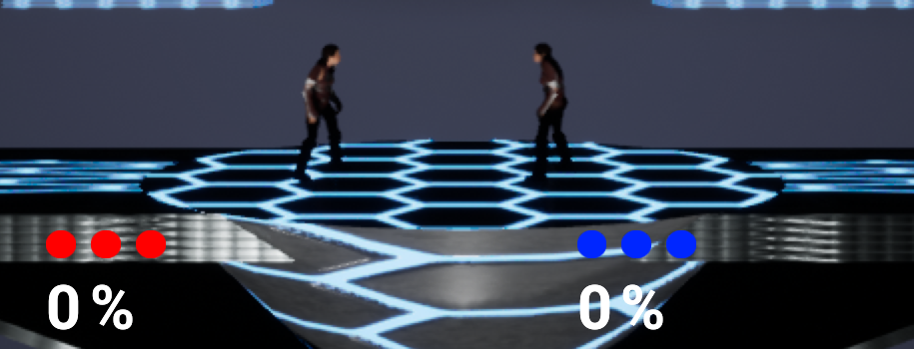
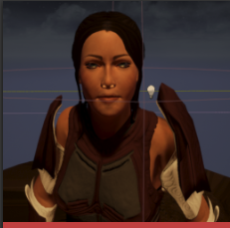
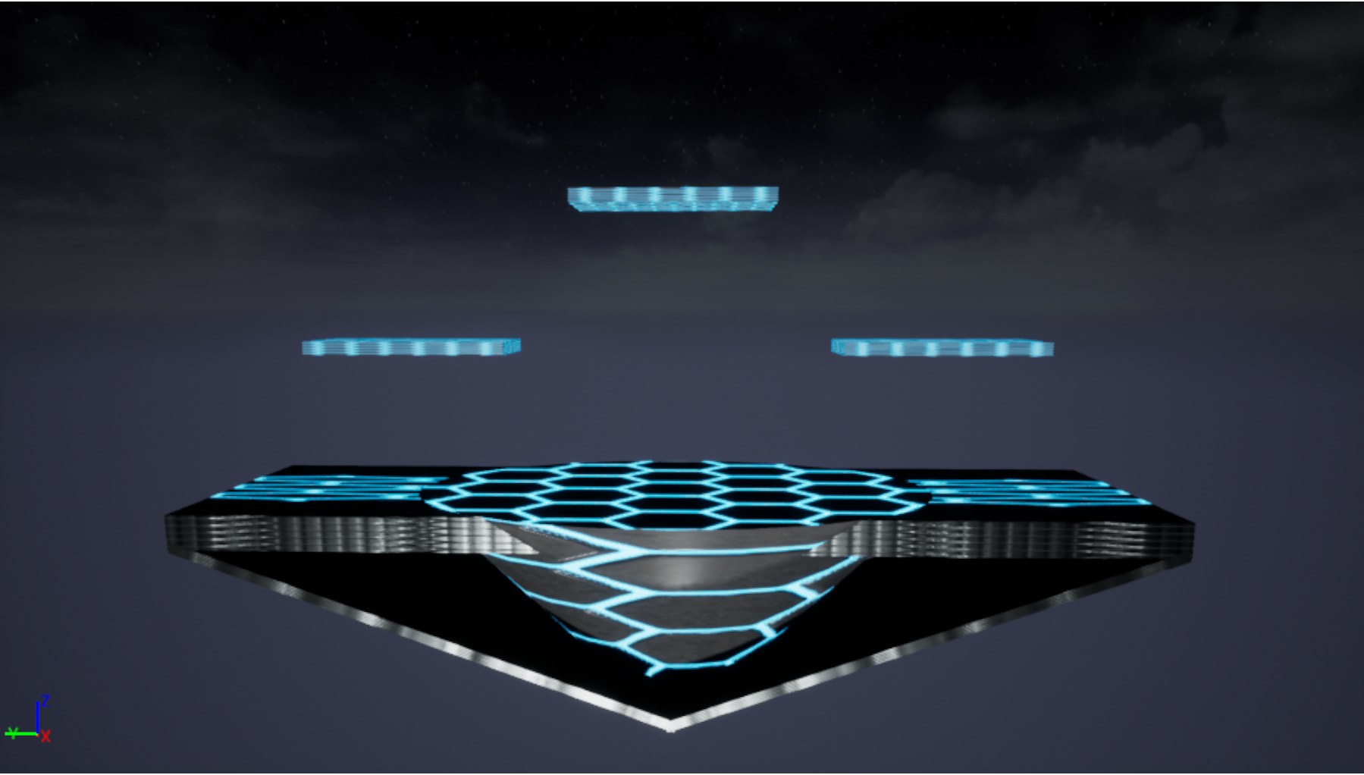
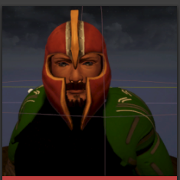
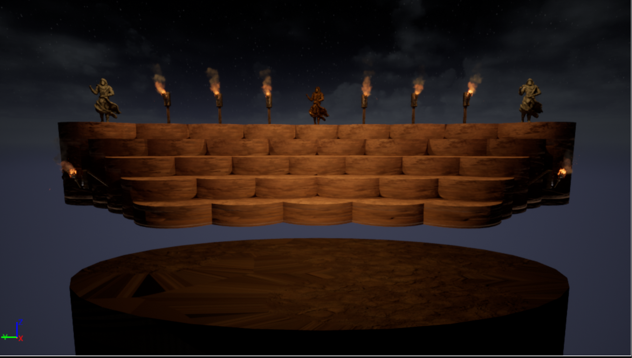
Stride Champions
Jeremy Cross, Software Systems Engineering, University of Regina
Taylen Jones, Software Systems Engineering, University of Regina
Intro
Results
Conclusion & Discussion
The world of gaming has a wide variety of applications to the real world. From social, leisure, competitive and public to scientific, educational or even training for specific tasks. That is why the field of game development is so important, while also having the potential of being very complex.
Stride Champions was developed as our 4th year engineering project at the University of Regina. The purpose of this project was to act as an introduction into the field of game development and the different software used.
Also, it was used as a method of applying our knowledge of the software engineering process learned over our University careers.
Graphics and UI
User Interface Design focuses on anticipating what users might want to do and ensuring that the interface has the necessary information available as to not make new users potentially feel overwhelmed.
Storyline
In our world there are a number of parallel universes, each with their unique properties and inhabitants, but also similarities. While all these universes are unknown to each other, at the center there is one who rules them all. Simply known as “The Elder”, he watches over the known realms keeping their peace and secrecy unknown. Every millennium, a tournament is held among the Universes simply called the “Stride Tournament”. The Elder sends his messengers to find the strongest fighters from each of the universes, and bring them together for an all-out, single elimination tournament to discover who is the strongest. The Elder promises the winner a single wish, anything their heart desires. But what the contestants don’t know is that the tournament hold a deeper, darker secret for the losers.
Our direction with the story allowed us to potentially develop characters with many different, unique personalities by leaving it open ended.
We felt that by picking a specific theme we might restrict our creativity.
The main objective of the development of Stride Champions was not only to further our skills in game development, storytelling and software engineering, but also to create a fun and interesting platform fighter from nothing.
In the end we were able to learn from the various software and implement all the different features that come with game design, such as: Stage/level creation, character design, game logic coding, storytelling, music, UI development, etc.
Also, we are able to gain experience using various software engineering methods with bi-weekly scrums and presentations.
Mechanics
The mechanics of our game take inspiration from the more successful games among the platform fighting genre. Players square off in 1 on 1 combat, with the goal being to reduce the other players stocks to 0 by forcing them into the blast zones. The players can go about this by increasing the other players damage percentage, which will in turn increase the knockback they receive from attacks. Players have options for how to attack their opponent, each character has their own unique punch, kick, aerial attack, guard, and also the ability to double jump.
Methods & Software
Literature Cited & Acknowledgments
Game Engine – Unreal Engine 4
Character Design – Adobe Fuse
Rigging and Animation – Mixamo
Character Bio Cards – Milanote
Brainstorming and Creative Sessions
We conducted these sessions between the 2 of us, and along with our professors, to come up with new ideas and directions with which to take the game.
Agile Method
Agile is a process by which we could manage our project by breaking it up into different stages and involving constant collaboration with stakeholders to allow for continuous improvement at every stage. In our case we did not have stakeholders, so they were replaced with course instructors and professors
Big thanks to Tim Maciag for guidance and suggestions throughout the duration of the entire project.
Characters
We have 2 fully functional characters, each with their own style and backstory. These characters were first modelled in Adobe Fuse, and then imported into Mixamo for easy rigging and animation.
Kelly Kyle – Our human female character
Ben Leon – Our human male character.
Stages
The stages for our game were created directly in the Unreal Game Engine.
We currently have 2 stages fully created and ready to use, the Cosmic Rift stage, along with a Roman Coliseum inspired stage.
Each of the stages comes with its own original music we created. Giving some more life to the environment
Next Steps
Further development of the game including, but not limited too:
Addition of more characters, stages, etc.
Development of a single player story mode
Implementation of in-battle items
External controller compatibility
Further testing on final prototype

